Slide 1
Countries

Slide 2

Where is he from?
He’s from Brazil.

Slide 3

Where is he from?
He’s from Australia.

Slide 4

Where is he from?
He’s from Canada.

Slide 5

Where is he from?
He’s from China.

Slide 6
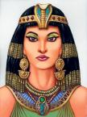
Where is she from?
She’s from Egypt.

Slide 7
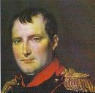
Where is he from?
He’s from France.

Slide 8
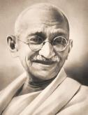
Where is he from?
He’s from India.

Slide 9

Where is she from?
She’s from the United Kingdom.

Slide 10
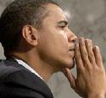
Where is he from?
He’s from the United States of America.

Slide 11

Where is he from?
He’s from the Philippines.

Slide 12
Thanks for using PowerPoint
At www.eslkidsworld.com
Goodbye!

